Slide 1
“Teach A Level Maths”
Statistics 1
The Geometric Distribution
© Christine Crisp

Slide 2
Statistics 1
OCR
"Certain images and/or photos on this presentation are the copyrighted property of JupiterImages and are being used with permission under license. These images and/or photos may not be copied or downloaded without permission from JupiterImages"

Slide 3

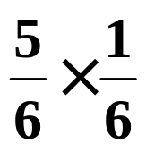
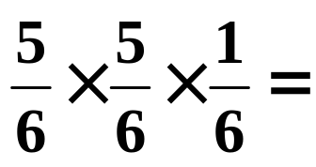
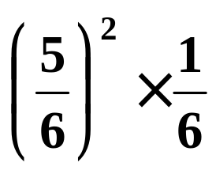
When playing some board games we have to roll a six with a die before we can begin.
The probability of rolling a six with the 1st try is .
The probability of not getting a six directly but getting one with the 2nd try is
and failing twice but succeeding the 3rd time is
and so on.

Slide 4





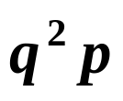

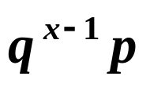
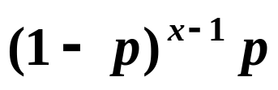
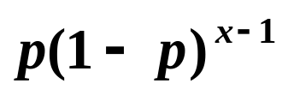
In general, if X is the random variable “ the number of trials to success”, and if the probability of success is p and the probability of failure is q, where p + q = 1, then
and so on.
This distribution is called the geometric distribution.
The general term is given by
Substituting for q, we get
In your formulae book this is written as
The next page proves that X is a random variable but if you haven’t studied the Geometric Series in Pure Maths, skip over it.
SKIP

Slide 5
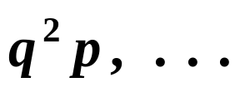


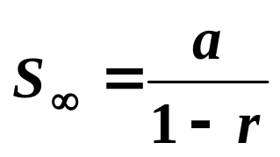



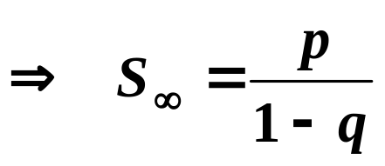

The sequence of probabilities for X = 1, 2, 3, . . . form an infinite geometric sequence:
The sum of an infinite number of terms is
where a is the 1st term and r is the common difference.
So, since
and
Since q = 1− p, we have 1 – q = p, so,
The sum of the probabilities equals 1, the condition for a random variable.

Slide 6
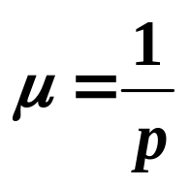
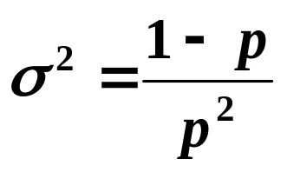

The Mean and Variance of the Geometric Distribution
The mean and variance of the Geometric Distribution are given by
mean,
variance,
A random variable, X, with a geometric distribution is written as

Slide 7

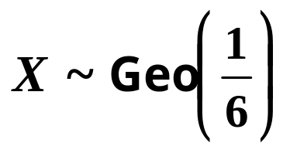


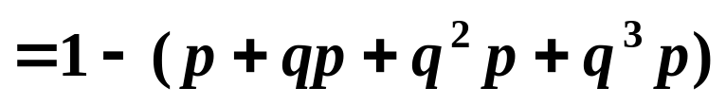
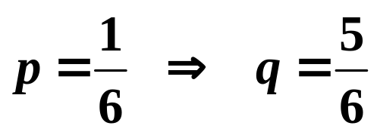


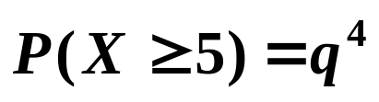
Finding
There are 2 ways of reasoning to get to the result.
e.g. Suppose we have and we want
Method 1:
so, using a calculator, we get
The probability of success on the 5th trial, or the 6th, or the 7th etc. means we have failure on the 1st 4, so, . We get the same answer.
Method 2:

Slide 8

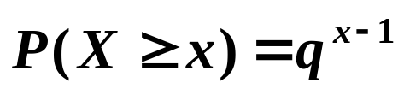
SUMMARY
If X is a random variable “ the number trials to success” then
and so on.
where, p is the probability of success and
q = 1 – p is the probability of failure.
We write
The mean of X is given by
The variance of X is given by
( These results are in the formulae booklet )
Also,

Slide 9

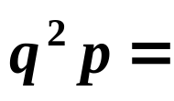
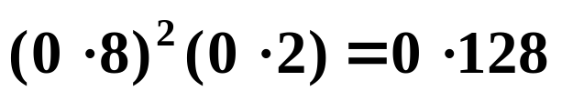
Exercise
1. When a darts player aims at a “double 20” on the board the probability of hitting it is 0·2.
(a) What is the probability of hitting the double 20
  (i) for the 1st time with the 3rd dart,
(ii) not hitting it in 10 tries?
(b) Find the expected number of throws before the double 20 is hit.
Solution:
Let X be the random variable “ number of times until the double 20 is hit”
Then,
(a)(i)

Slide 10

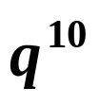


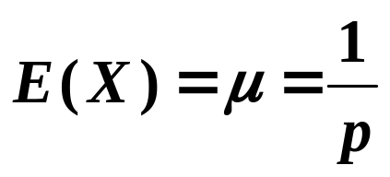

(a) What is the probability of hitting the double 20
  (i) for the 1st time with the 3rd dart,
(ii) not hitting it in 10 tries?
(b) Find the expected number of throws before the double 20 is hit.
(a)(ii) We need
(b)

Slide 11


Slide 12
The following slides contain repeats of information on earlier slides, shown without colour, so that they can be printed and photocopied.

Slide 13
In general, if X is the random variable “ the number of trials to success”, and if the probability of success is p and the probability of failure is q, where p + q = 1, then
and so on.
This distribution is called the geometric distribution.
The general term is given by
Substituting for q, we get
In your formula book this is written as

Slide 14
Finding
There are 2 ways of reasoning to get to the result.
e.g. Suppose we have and we want
Method 1:
so, using a calculator, we get
Method 2: The probability of success on the 5th trial, or the 6th, or the 7th etc. means we have failure on the 1st 4, so, . We get the same answer.

Slide 15
SUMMARY
If X is a random variable “ the number trials to success” then
and so on.
where, p is the probability of success and
q = 1 – p is the probability of failure.
We write
The mean of X is given by
The variance of X is given by
( These results are in the formula booklet )
Also,

